Slide 1
Intelligent Code Editor
Team sdmay20_46
Members Keaton Johnson, Jonathan Novak, Matthew Orth, Garet Phelps,
Isaac Spanier, John Jago
Client & Adviser Professor Ali Jannesari and Hung Phan
Website http://sdmay20-46.sd.ece.iastate.edu
Garet Phelps

Slide 2
Project Overview
sdmay20-46: Intelligent Code Editor
Create system that takes natural language input from user and converts to Java code
Key contributions
User interface (IntelliJ plugin)
Natural language and Java code preprocessing
Automatic dataset mining method
Dataset
Classification/translation model (OpenNMT-py)
Garet Phelps
Notes:
The CORE idea of this project
English to java code

Slide 3
Problem Statement
sdmay20-46: Intelligent Code Editor
Software is becoming more prevalent in fields where it previously did not exist
Our solution is an IntelliJ plugin that converts English into Java code
Relevant to people who may need to write code occasionally, but it is not their main expertise.
Bioinformatics (COM S 444)
Statistics
Note: to use our project users will have to have at least a basic understanding of programing concepts.
Garet Phelps
Notes:
More and more fields are requiring programming work to use cutting edge technologies
The thought is that by easing the syntactical burden of writing code it could be easier for more people to utilize programming in their field.

Slide 4
Project Milestones
sdmay20-46: Intelligent Code Editor
Initial Research on technologies and plan (September 2019)
Develop System.out.println dataset (October 2019)
Implementing the UI, Neural Machine Translation, and Dataset in isolation (December 2019)
Develop an automatic dataset mining and preprocessing (February 2020)
Java method invocation dataset (March 2020)
Integrate UI, Neural Machine Translation, Preprocessing, and Dataset together (April 2020)
Jonathan Novak

Slide 5
Conceptual Sketch
sdmay20-46: Intelligent Code Editor
Jonathan Novak

Slide 6
Requirements
sdmay20-46: Intelligent Code Editor
Functional
User can select or otherwise input the text they wish to translate to code
User can trigger a translate action
The textual descriptions are replaced by the translated code fragments
The translated code fragments compile correctly
Non-functional
Translation time should be fast such that it does not slow down the user’s development pace
Jonathan Novak

Slide 7
Technical Constraints and Considerations
sdmay20-46: Intelligent Code Editor
Constraints
Only one method invocation should be translated at a time
Java method invocations are the only supported code translations
Project size scoping
Considerations
Translation action should be easily accessible from the text editor area
The user interface should be clean and easy to understand
Intended users are those with programming experience
Isaac Spanier
Notes:
Highlighting text should be easy from the IntelliJ plugin -> Which it is using the Shift + T - Shortcut
We believe the

Slide 8
Potential Risks and Mitigation
sdmay20-46: Intelligent Code Editor
Ambiguous natural language
Limited translations to only support Java method invocations
Only support a single method translation at a time
Better results achieved when the user has some Java programming domain knowledge, but doesn’t know the exact syntax
Poor translation accuracy
Reduced input variation with sentence preprocessing
Improved accuracy by using a larger dataset to train the model
Isaac Spanier
Notes:
Resulted in a ____ percent translation accuracy
No multi - method invocation at a time
Pass it to Matthew with Design Diagram

Slide 9
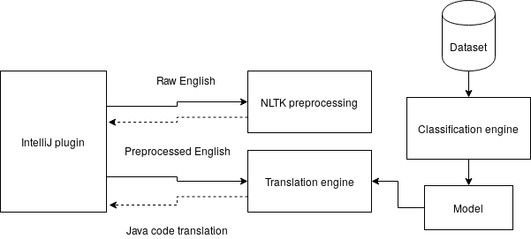
Design Diagram
sdmay20-46: Intelligent Code Editor
Matthew Orth

Slide 10
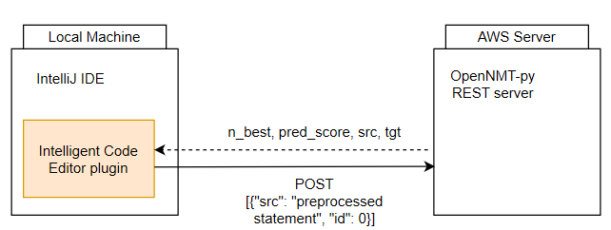
Functional Decomposition
sdmay20-46: Intelligent Code Editor
Matthew Orth
Notes:
Plugin for the IntelliJ Platform
Java
OpenNMT is a neural machine translation system
Provides the framework for creating deep learning models
IEEE standards
1028-2008: Software reviews and audits
16326-2009: Project management
1008-1987: Unit testing

Slide 11
Software Tools
sdmay20-46: Intelligent Code Editor
Matthew Orth

Slide 12
Engineering Standards and Design Practices
sdmay20-46: Intelligent Code Editor
IEEE 1028-2008, IEEE 16326-2009, IEEE 1008-1987
Agile Workflow
Test Driven Development
Matthew Orth

Slide 13
Testing
sdmay20-46: Intelligent Code Editor
IntelliJ plugin
Unit tests (JUnit 5)
Integration tests
Acceptance tests
Language model (OpenNMT)
Verification of results was mostly manual
Automated feedback in the form of the test dataset
52% accuracy
Versus 36% in anyCode paper
John Jago
Notes:
Component/unit testing (tied to requirements)
Unit tests ensure individual features of the plugin are working as expected
For example, if the server returns a list of multiple possible translations, the UI should display all those options
Interface/integration testing
Manual UI testing ensures that interaction with the plugin is intuitive
OpenNMT-py REST API communication
System level testing/acceptance testing
Novice programmers will try to create some method invocations by only typing in English
Manual verification of model performance
Test set gives some automated feedback

Slide 14
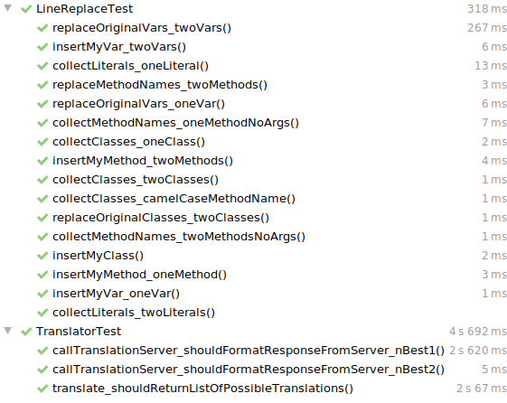
John Jago

Slide 15
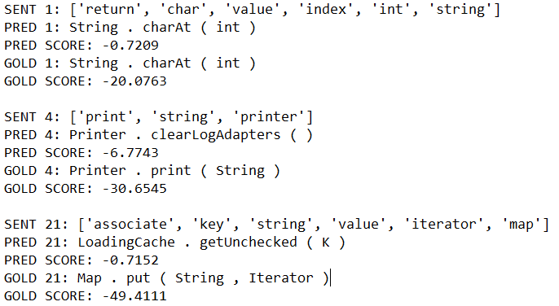
Good
Close
Wrong
John Jago

Slide 16
Implementation
sdmay20-46: Intelligent Code Editor
Dataset for printing to standard output [ System.out.println(...) ]
5020 lines of English/Java pairs
~40% accuracy
Dataset for Java method invocations
Over 1,500 data points with 1,000 unique Java methods
52% accuracy
Plugin UI
John Jago

Slide 17
int x = 1;
int y = 2;
max of x and y
IDE
“max of int and int”
Preprocessing
1
OpenNMT-py REST
4
Post-processing
2
3
Math . max ( int, int )
Our model
John Jago

Slide 18
int x = 1;
int y = 2;
Math.max(x, y);
IDE
“max of int and int”
Preprocessing
1
OpenNMT-py REST
4
Post-processing
2
3
Math . max ( int, int )
Our model
John Jago

Slide 19
John Jago

Slide 20
John Jago

Slide 21
Specifications and Analysis
sdmay20-46: Intelligent Code Editor
Design description and Analysis
User Interface
NLTK Preprocessing
Classification and Translation Engine
Dataset
Keaton Johnson

Slide 22
User Interface
sdmay20-46: Intelligent Code Editor
IntelliJ plugin for the UI
User inputs natural language and translates by selecting a “translation” button
Utilizes NLTK preprocessing
Connects to translation engine
Primary Contributions: John Jago and Garet Phelps
Strengths
High Documentation
Easy to install
Easy to utilize
Weaknesses
Limited editor modification
(Able to add all functionality we needed)
Keaton Johnson

Slide 23
NLTK Preprocessing
sdmay20-46: Intelligent Code Editor
Converts user input
Removes non-verb and non-nouns
Converts to present tense
Converts all characters to lowercase
Primary Contributions: Matthew Orth and Isaac Spanier
Strengths
Well-known and high performing
Supports all preprocessing required
Weaknesses
NLTK requires modifications to work
Keaton Johnson

Slide 24
NLTK Preprocessing Output
sdmay20-46: Intelligent Code Editor
Input Statement: return the char value at index pos+1 for str
Preprocessed Statement: return char value index int string
Keaton Johnson

Slide 25
Classification and Translation Engine
sdmay20-46: Intelligent Code Editor
Built using OpenNMT-py
Uses preprocessed data as input
Provides translation as output
Primary Contributions: Matthew Orth and Jon Novak
Strengths
Well-documented and widely used
Easy interface for model architecture configuration
Weaknesses
Models take a long time to train
Persisted regardless of system
Keaton Johnson

Slide 26
Dataset
sdmay20-46: Intelligent Code Editor
Natural language is the source
Expected code is the target
Code Statements generated by mining GitHub’s top repos for most used methods.
Natural language was manually generated
Primary Contributions: Everyone
Strengths
Automatic statement mining saved time
Able to generate a lot of usable data
Weaknesses
Different group members may translate a statement differently
Keaton Johnson

Slide 27
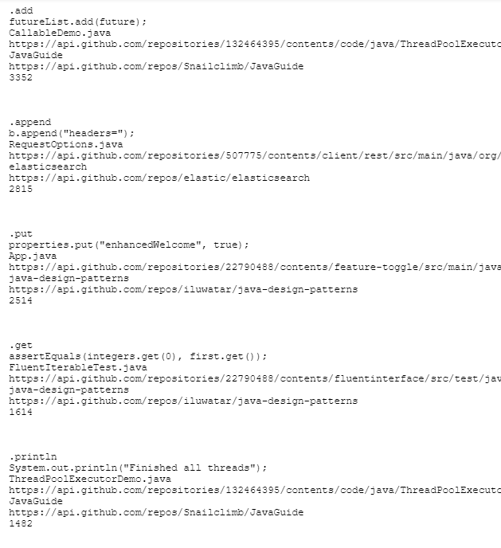
Broad Dataset
sdmay20-46: Intelligent Code Editor
Core Method
Example Method
Example source file
Example file link
Java project
Project link
Number of occurrences within mining
Keaton Johnson

Slide 28
Future State of Project
sdmay20-46: Intelligent Code Editor
Technical Improvements:
Create automated method to generate dataset
Optimize neural machine translation system using GANs, BERT, etc.
General Improvements:
Support more than Java method invocations
Support different input methods like text to speech
Keaton Johnson

Slide 29
Questions?

Slide 30
Thank you

